Slide 1
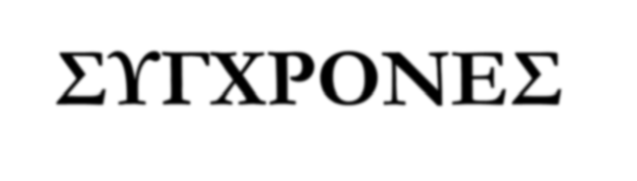
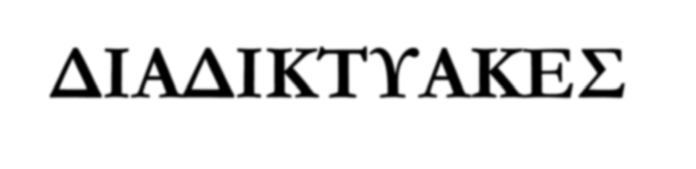
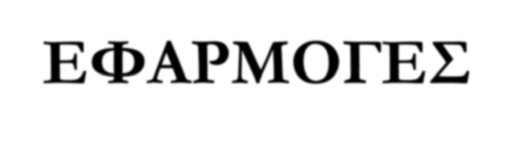
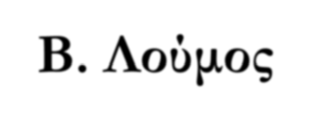
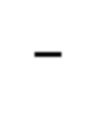
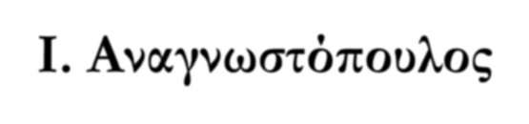
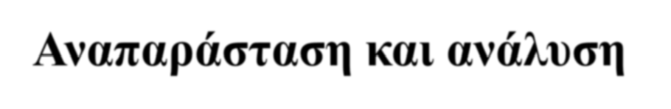
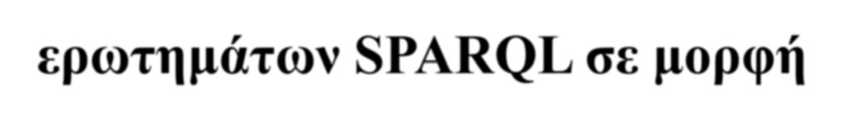
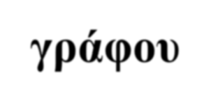



ΣΥΓΧΡΟΝΕΣ ΔΙΑΔΙΚΤΥΑΚΕΣ ΕΦΑΡΜΟΓΕΣ
Β. Λούμος – Ι. Αναγνωστόπουλος
Αναπαράσταση και ανάλυση ερωτημάτων SPARQL σε μορφή γράφου
Κορμανιώτης Τρύφων – Κουτσανδρέας Αδαμάντιος

Slide 2
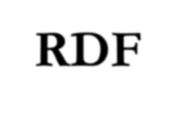

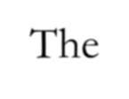
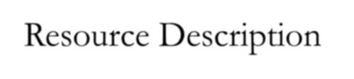
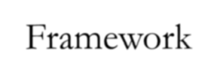
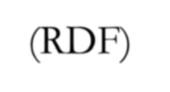
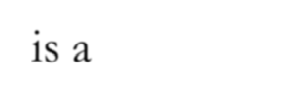
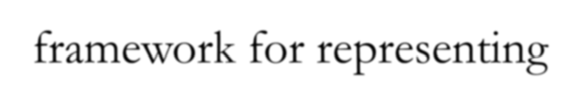
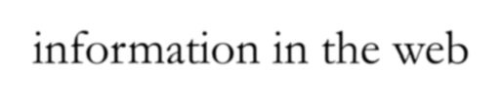

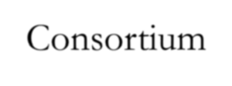
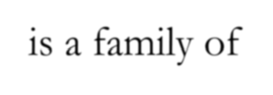
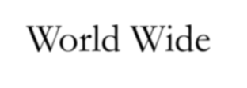
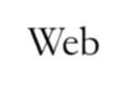
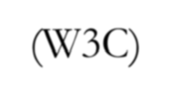
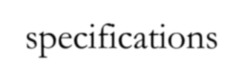


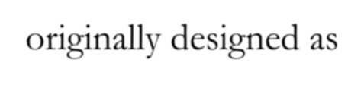
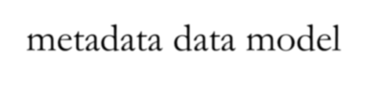
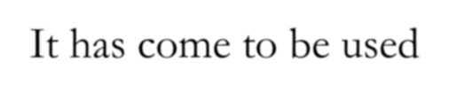
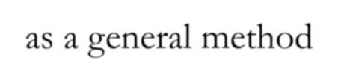
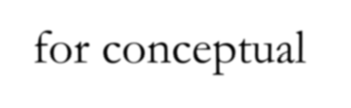
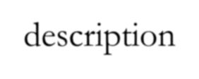
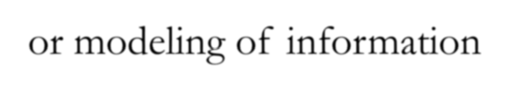
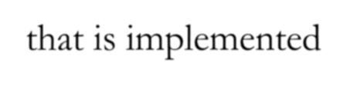
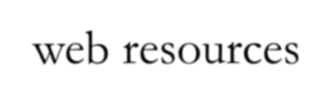
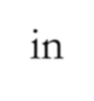

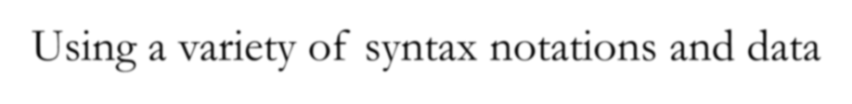
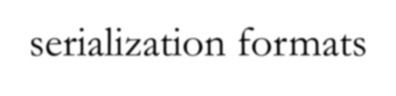
The Resource Description Framework (RDF) is a framework for representing information in the web
RDF
It is a family of World Wide Web Consortium (W3C) specifications, originally designed as a metadata data model
It has come to be used as a general method for conceptual description or modeling of information that is implemented in web resources
Using a variety of syntax notations and data serialization formats

Slide 3
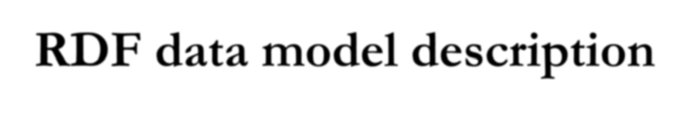

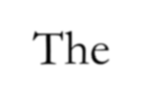
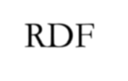
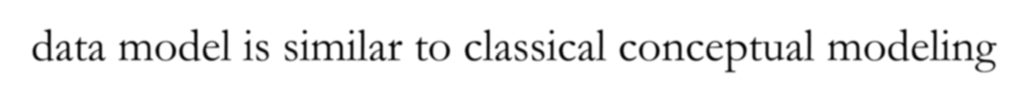
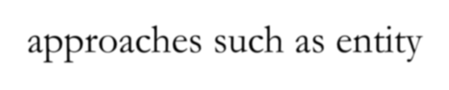

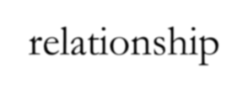
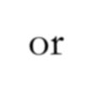
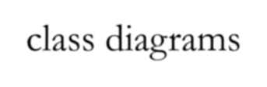
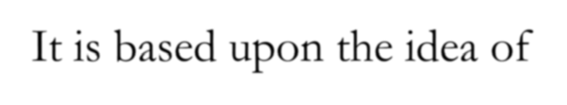
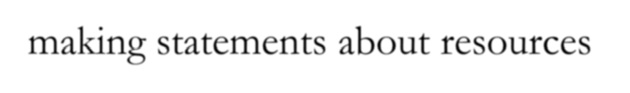
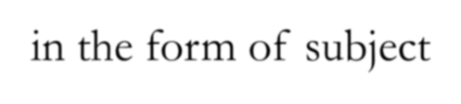
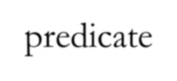
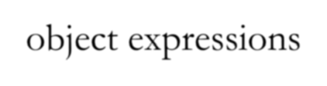
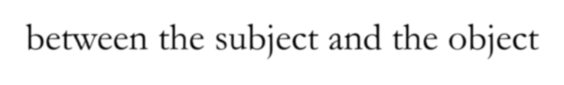
RDF data model description
The RDF data model is similar to classical conceptual modeling approaches such as entity-relationship or class diagrams
It is based upon the idea of making statements about resources
in the form of subject-predicate-object expressions
These expressions are known as triples in RDF terminology
The subject denotes the resource, and the predicate denotes traits or aspects of the resource and expresses a relationship between the subject and the object

Slide 4
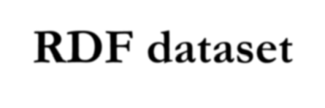










RDF dataset
An RDF dataset comprises one default graph and zero or more named graphs
RDF graphs are sets of subject-predicate-object triples
the elements may be IRIs( generalization of URIS), blank nodes, or datatyped literals.
RDF graphs are used to express descriptions of resources
There are some controlled vocabularies in common use
The intent of publishing RDF-based ontologies on the Web is often to establish, or circumscribe, the intended meanings of the resource identifiers used to express data in RDF

Slide 5








RDF Schema- RDFs
RDFs is a semantic extension of RDF
RDFs defines classes and relations of resources and organize their hierarchy
RDFs defines signatures of relations (domain, range), documents them with labels and comments
RDFs defines associated inference rules

Slide 6



















RDF Applications
DBpedia
Creative Commons
FOAF(friend of a friend)
Haystack Client
MusicBrainz
NEPOMUK
Simple knowledge
Organization System
SIOC(Semantically- Interlinked Online Communities)
Smart-M3
IDEAS Group
Microsoft RDF-based Profile Management
RDF enables you to open your data to applications through the web

Slide 7















SPARQL
SPARQL ( SIMPLE Protocol and RDF Query Language) is
an RDF query language (semantic) which is able to retrieve and manipulate data stored in Resource Description Framework (RDF) format.
It was made a standard by the RDF Data Access Working Group (DAWG) of the World Wide Web Consortium
It is recognized as one of the key technologies of the semantic web
SPARQL protocol sending queries and their results across the web

Slide 8










SPARQL
Beside a query language, it is a result format and an access protocol for RDF
It is declarative and it is based on RDF data model (triples/graph)
SPARQL queries are executed against an RDF dataset
SPARQL query language based on the triple model filters to add constraints, optional and alternative parts
SPARQL allows for a query to consist of triple
patterns, conjunctions, disjunctions, and optional patterns.

Slide 9



































SPARQL Basic clauses
select :to identify the values to be returned
from :to identify the data sources to query
where :to identify the triple/graph pattern to be matched against the
triples/graphs of RDF
prefix :to declare the schema used in the query
filter :to add constraints to the graph pattern
optional :to make the matching of a part of the pattern optional
union :to give alternative patterns in a query
order by :to sort
limit :result number
offset :rank of first results
unbound :to test a variable I not bound
construct :return a spesific RDF graph for each result

Slide 10











Graph patterns for the SPARQL query pattern
Basic Graph Pattern (BGP)
Group Graph Pattern
Optional Graph Pattern-keyword Optional
Union Graph Pattern-keyword Union
Graph graph pattern-keyword Graph
Constraints-keyword Filter

Slide 11








join ordering problem
The join ordering problem is a fundamental challenge that has to be solved by any query optimizer
A query is a request for information from a database
Depending on the order of the join, there is a different computation time
The query optimizer attempts to determine the most efficient way to execute a given query by considering the possible query plans
We focus on static query optimization ,a join order optimization of triple patterns performed before query evaluation.

Slide 12
















Join ordering problem at RDF systems
Namely in RDF systems the optimizers are faced with extremely large sizes of queries due to verbosity of the data format
SPARQL follows a sequential semantics when evaluating join groups
although in many cases the order of evaluating patterns does not change the outcome of the query
The optimization goal is:
to find the execution plan which is expected to return the result set fastest and
without actually executing the query or subparts

Slide 13













The solution of the problem
This is typically solved by means of heuristics and summaries for statistics about the data
Queries results are generated by accessing relevant database data and
Manipulating it in a way that yields the requested information
Given a SPARQL query, the query engine starts off with constructing its representation
The representation is one of the Graph Patterns for the SPARQL query pattern mentioned above

Slide 14




















Two different approaches
RDF-3X:query compilation time (dominated by finding the optimization order) is one order of magnitude higher than the actual execution time
Virtuoso-7:greedy algorithm for compilation leads to slow run time (sub-optimal order ){seems to spend much less time finding the join order (probably employing some kind of greedy heuristics), but pays a high price for the (apparently) suboptimal ordering
Ideally, we would like to have a hybrid of two approaches: a heuristics that spends a reasonable amount of time optimizing the query, and yet gets a decent join order

